Slide 1



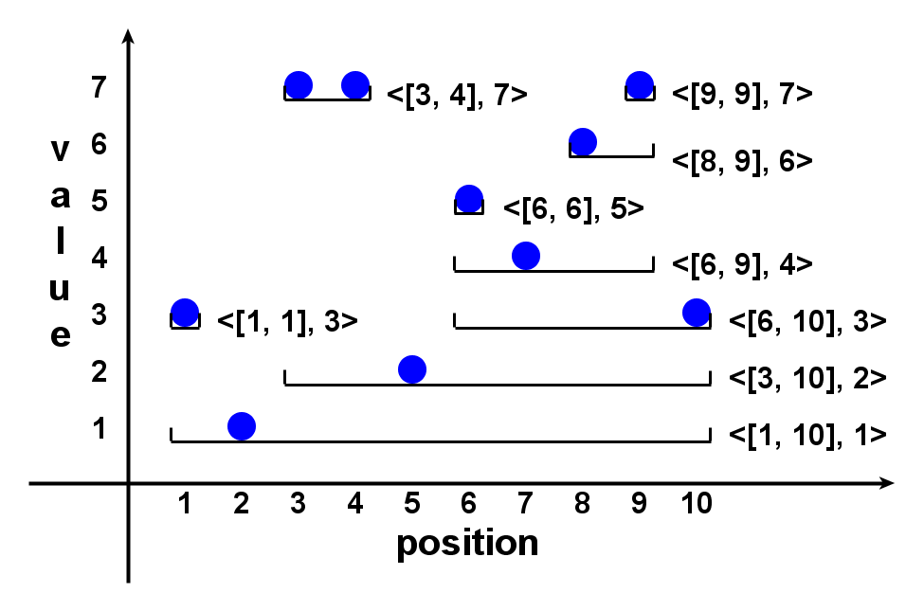
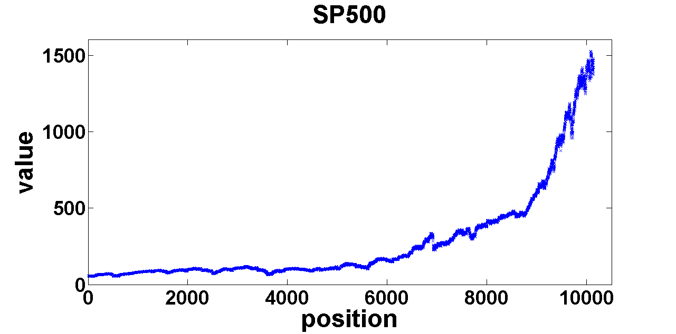
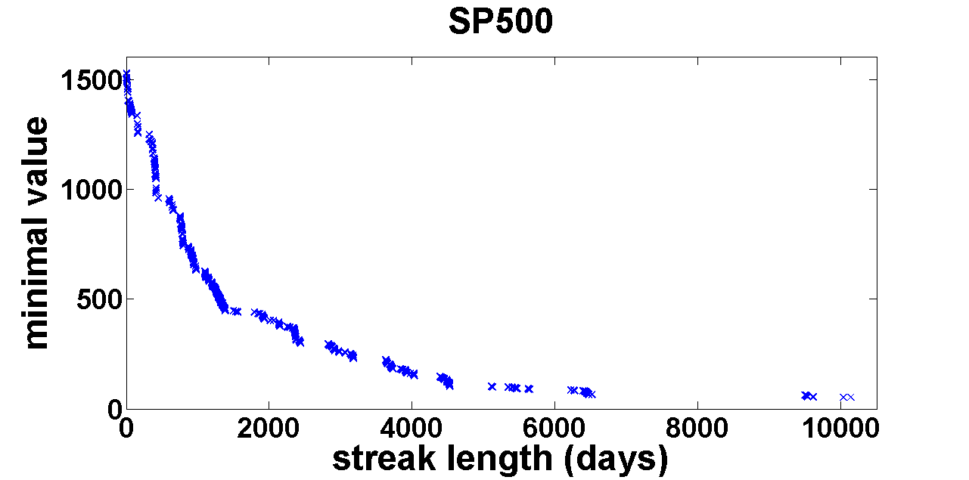
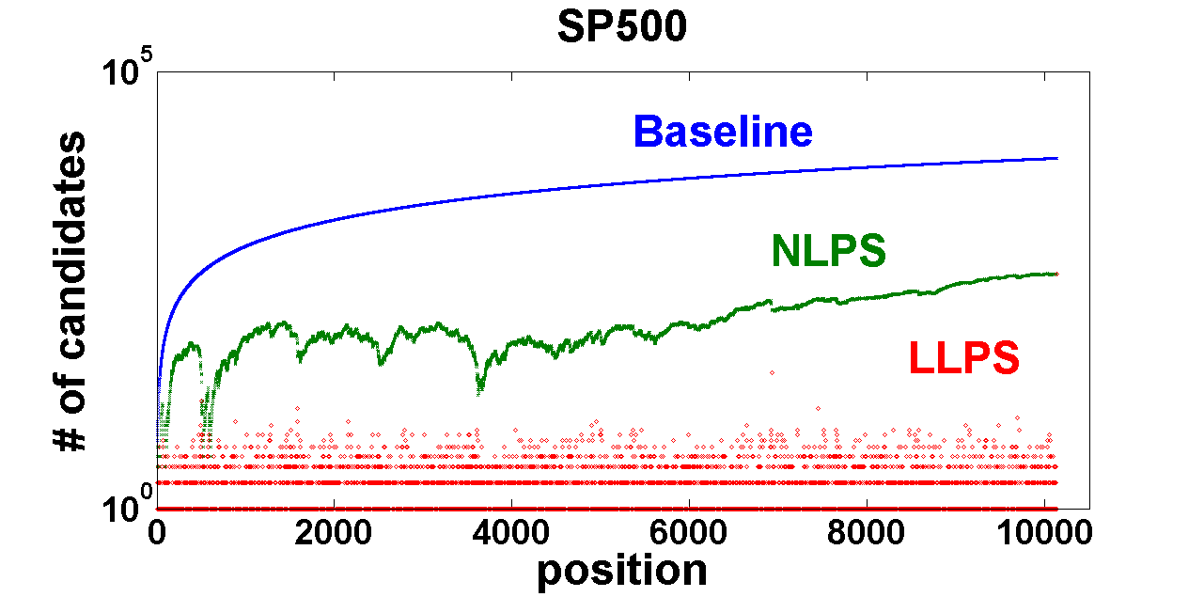


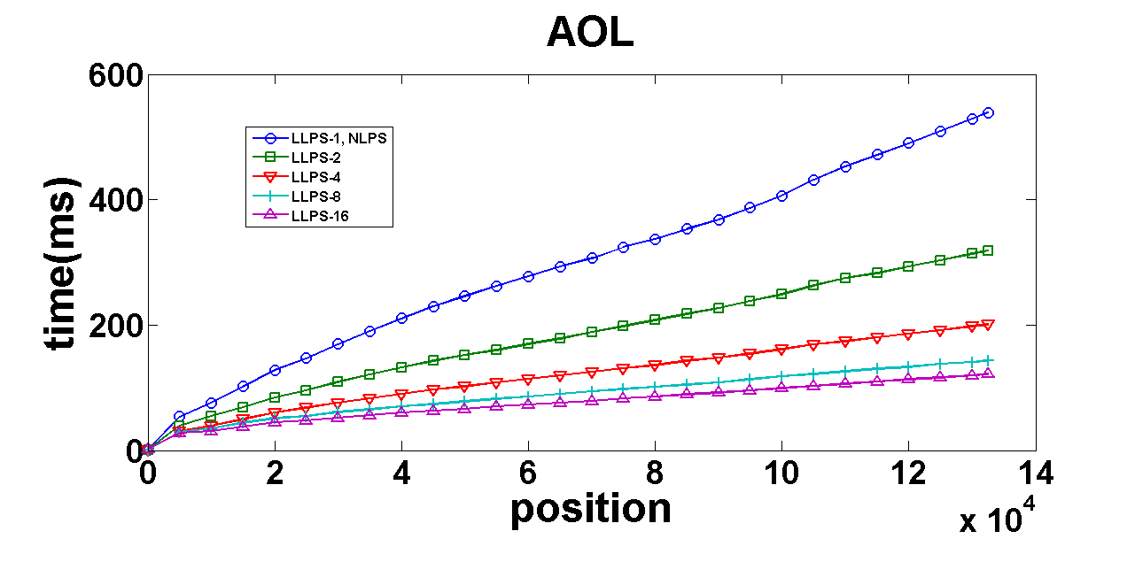
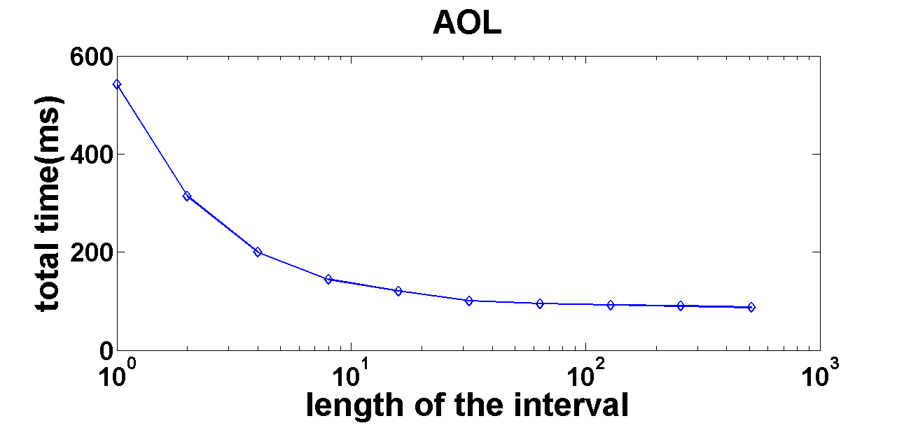
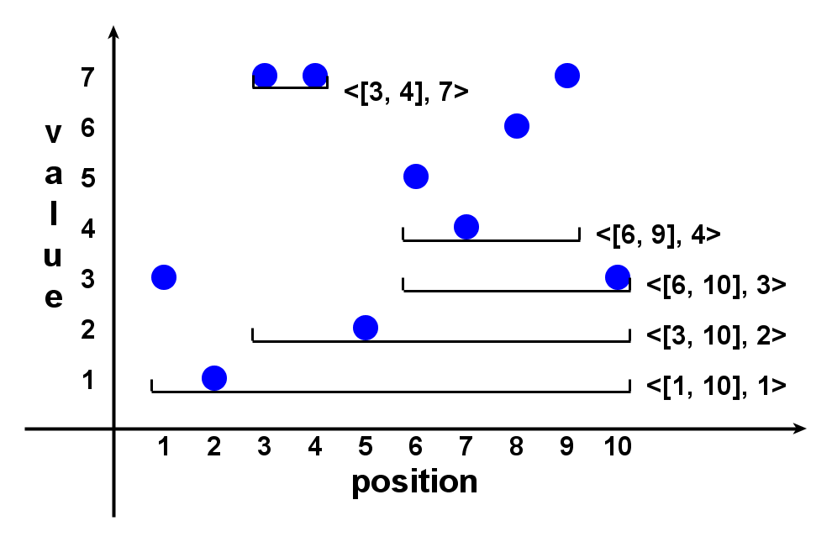
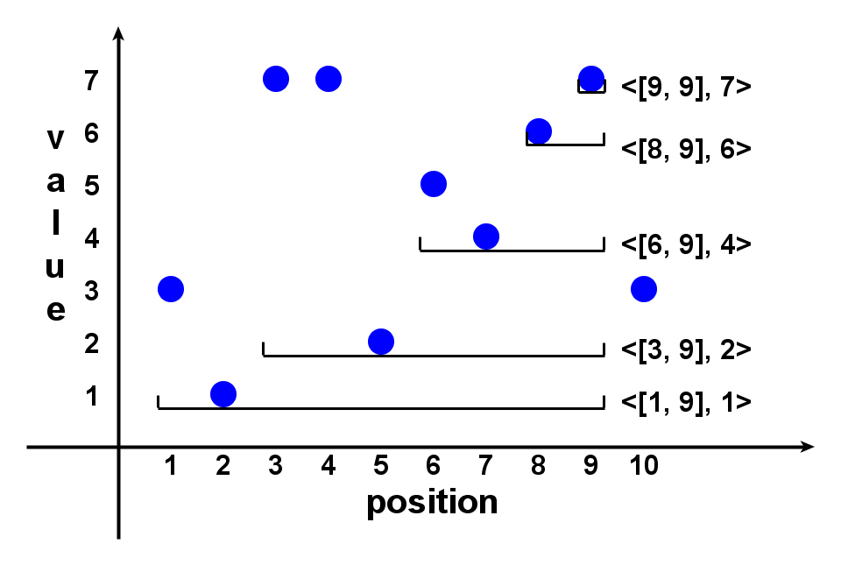
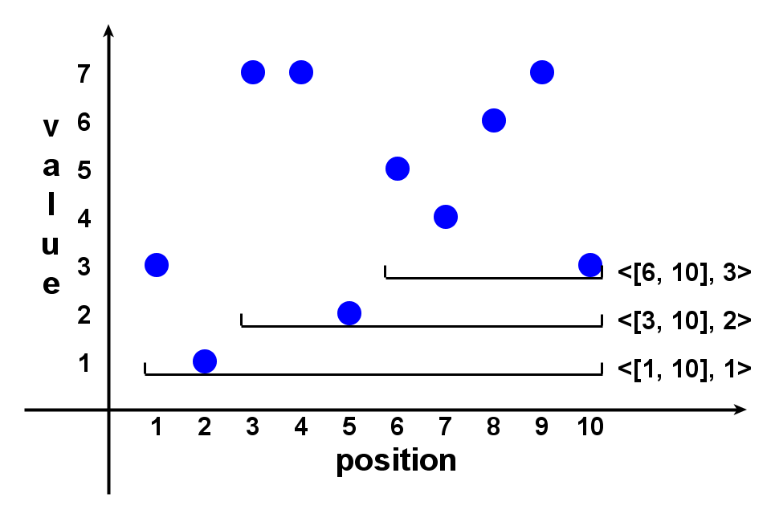
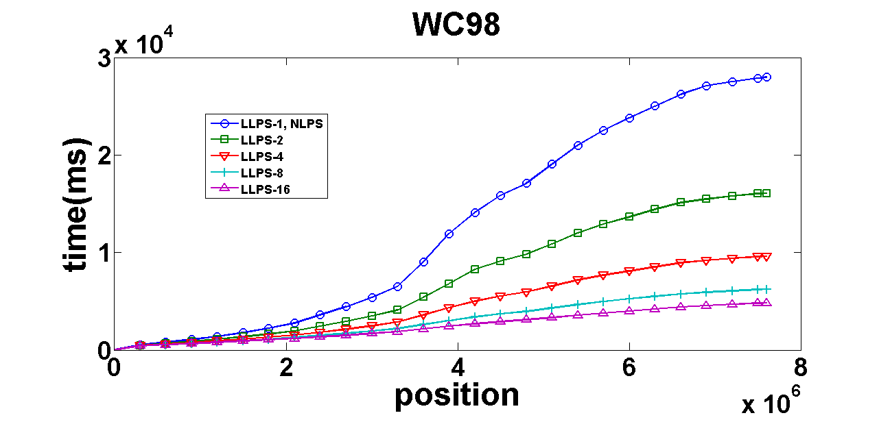
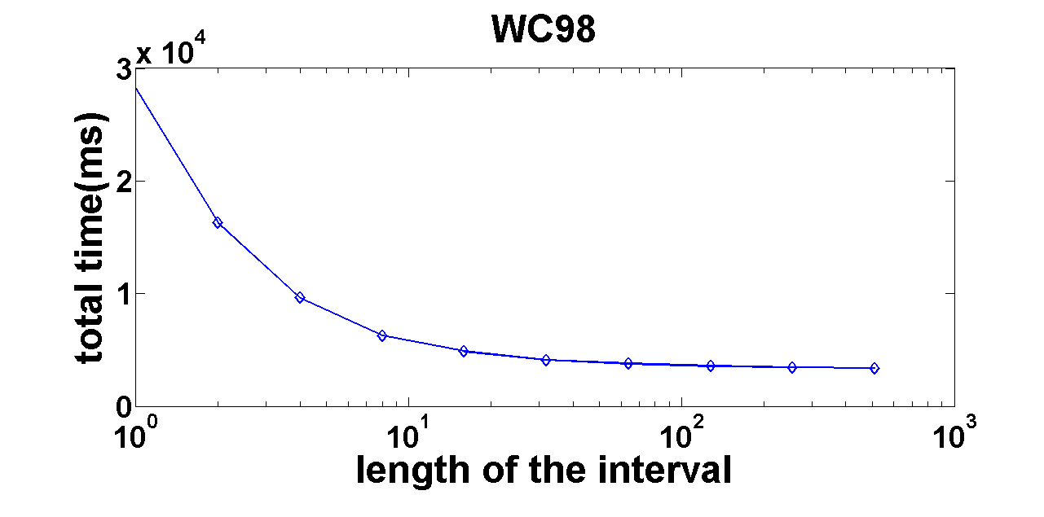
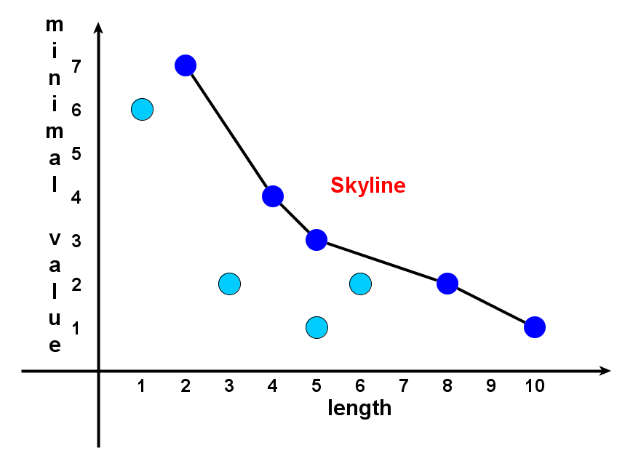
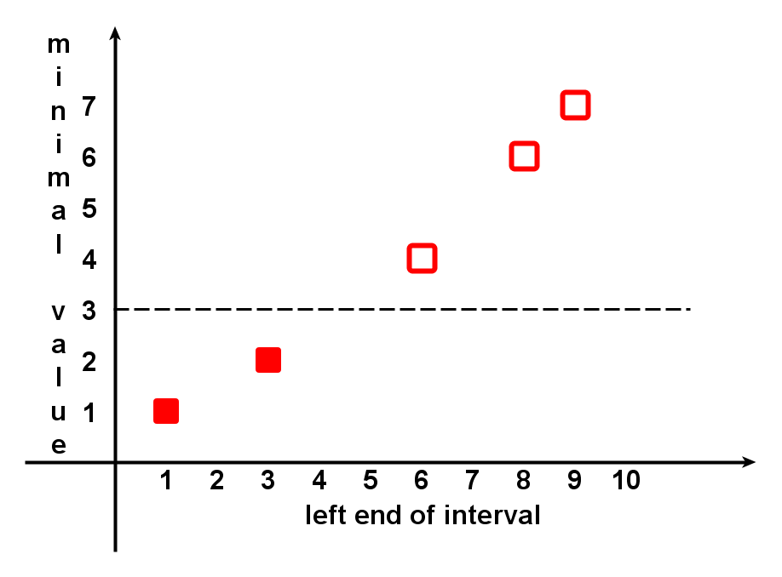
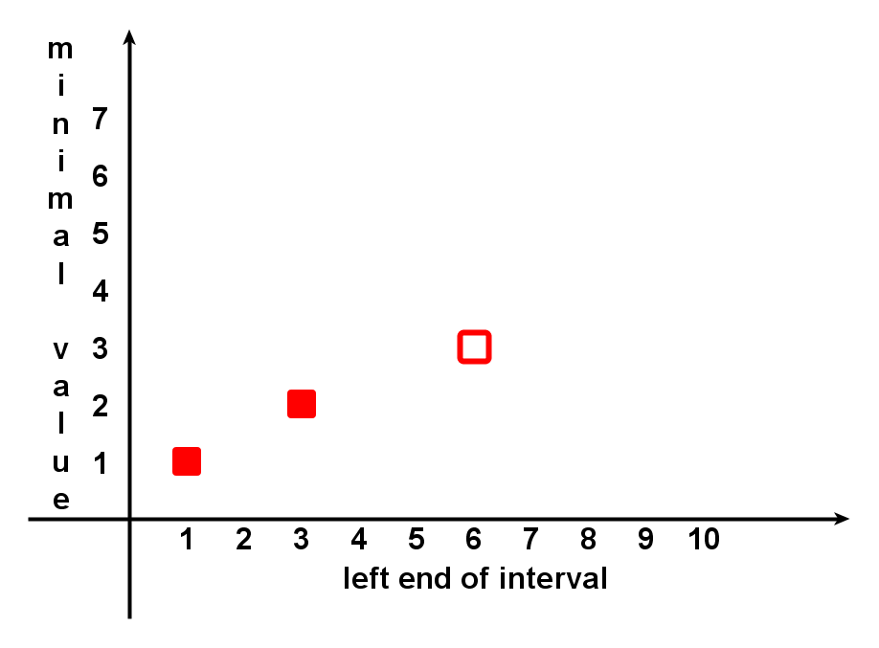


Prominent Streak Discovery in Sequence Data
Xiao Jiang , Chengkai Li , Ping Luo , Min Wang , Yong Yu
(¹ Shanghai Jiao Tong University; ² The University of Texas at Arlington; ³ HP Labs China)
1
2
3
3
1
1
2
3
1. Motivation
4. Local Prominent Streak
6. Experiments
Prominent streaks stated in news articles:
This month the Chinese capital has experienced 10 days with a maximum temperature in around 35 degrees Celsius – the most for the month of July in a decade.
The Nikkei 225 closed below 10000 for the 12th consecutive week, the longest such streak since June 2009.
He (LeBron James) scored 35 or more points in nine consecutive games and joined Michael Jordan and Kobe Bryant as the only players since 1970 to accomplish the feat.
Streak dominates streak locally iff
s1 dominates s2 and
Local prominent streaks (LPS) are streaks that are not locally dominated by others.
Property 1: prominent streaks are also LPS
Property 2: the number of LPS is less than or equal to sequence length
Conclusion: LPS is a good set of candidate streaks
Real-world datasets, sequence length from thousands to millions.
A variety of application scenarios, including meteorology, finance, network traffic.
Data sets | Length | #PS | Baseline(ms) | LLPS(ms)
Gold | 1074 | 137 | 78 | 9
River | 1400 | 93 | 78 | 3
Melb1 | 3650 | 55 | 390 | 12
Melb2 | 3650 | 58 | 387 | 15
Wiki1 | 4896 | 58 | 711 | 15
Wiki2 | 4896 | 51 | 711 | 15
Wiki3 | 4896 | 118 | 689 | 16
SP500 | 10136 | 497 | 4717 | 21
HPQ | 12109 | 232 | 6099 | 18
IBM | 12109 | 198 | 5079 | 22
AOL | 132480 | 127 | 446622 | 78
WC98 | 7603201 | 286 | >1 hour | 3404
2. Problem Formulation
In a sequence of values, a streak <[l, r], v> is the triple of left-end, right-end, and the minimum value in the interval. E.g.
3 1 7 7 2 5 4 6 7 3
<[6, 8], 4>
We define the Dominance Relationship:
Streak dominates streak iff
or
Prominent streaks are streaks that are not dominated by others.
Task 1: given a data sequence, compute the prominent streaks. E.g.
A closer look at SP500 (S&P 500 index, 06/1960-06/2000)
5. Linear LPS Method
1. Maintain a list of streaks when scanning the sequence rightward.
2. After scanning the kth value, right-ends of streaks in the list are all k.
3. When scanning (k+1)-th value, try to extend the streaks rightward.
4. After scanning the last value, all the streaks in the list are LPS.
3.1 Streaks whose v is less than (k+1)-th value should be extended.
3.2 Only the longest streak of the rest should be extended.
3.3 The streaks whose v is greater than (k+1)-th value are LPS.
Monitoring prominent streaks of AOL and WC98:
Monitoring:
Real-world data sequence often grows, with newly appended values.
Task 2: keep the prominent streaks up-to-date
Cumulative Execution Time at Various Positions, for Different Reporting frequencies
Total Execution Time by Reporting Frequencies
3. Solution Framework
As the streaks share the same right-end, the minimum values are increasing if the streaks are listed in the increasing order of left-ends. Figure below: l-v plot for the above example.
7. Interesting Prominent Streaks
Data Value Sequence
Melbourne daily min/max temperature between 1981 and 1990 (Melb1 & Melb2)
more than 2000 days with min temperature above zero
6 days: the longest streak above 35 degrees Celsius
Candidate Streaks
Traffic count of Wikipedia page of Lady Gaga (Wiki2)
more than half of the prominent streaks are around Sep. 12th (VMA 2010)
at least 2000 traffic hourly lasting for almost 4 days
Skyline Operation
Prominent Streaks

